Slide 1
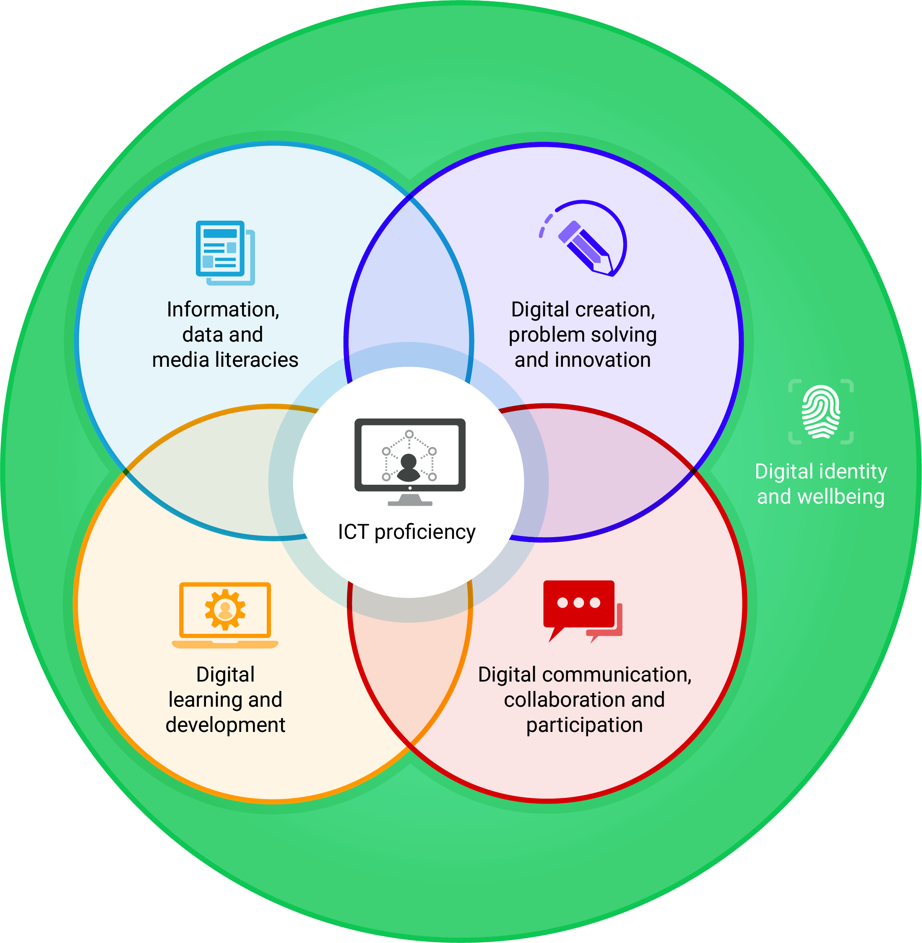
Talking about the Jisc digital capabilities framework
With Helen Beetham and Shri Footring
Notes:
I’m here with Helen Beetham, the original architect of the Jisc digital capability framework.
In this presentation we’ll talk about what the framework is and why it might be useful.

Slide 2
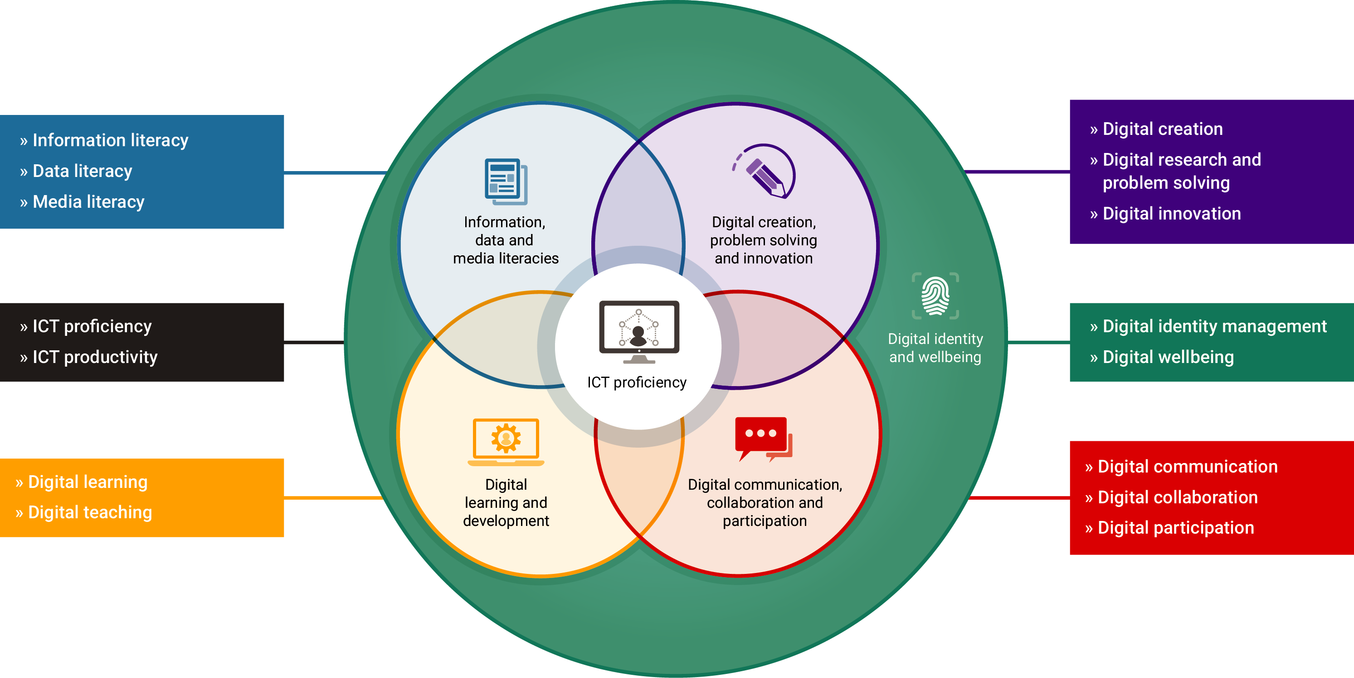
What is the digital capabilities framework?
Notes:
Shri: Helen, what is the digital capabilities framework?
Helen: Well Shri, it’s what we’re looking at now.
It’s really a kind of high-level way of thinking about what staff and students need to thrive in today’s educational settings which, as we know, are very highly defined and mediated by digital systems. The different ways that people might be well-resourced or hopefully to become well-resourced to deal with that. And I suppose for me we don’t think about people wanting to be digitally capable, it’s not an aspiration most people have. Students come to us because they want to enter a particular profession or explore a subject that they are really passionate about, and professionals in education want to be a great teacher or librarian or whatever.
So we have to have a framework that is really adaptable, that really can meet the needs of the different roles and needs that people have. But at the same there has to be something generic we can say, I think, about these new demands, new challenges, the new opportunities that exist because of the digital connectivity that we have in our classrooms.

Slide 3
Why a digital capabilities framework?
The framework:
Focuses on the new digital realities of education
Provides a shared, high level map or language for opening conversations
Was developed with stakeholder engagement
Articulates different examples of practice
Acts as a shared aspiration and benchmark
Supports development of tools and resources
Notes:
Shri: Thanks. So before we get in to the detail, which we will in other presentations, can you explain why we need a digital framework?
Helen: Ah, great question, Shri. Well, dealing with the digital part of it first, I guess it’s useful if we think that those digital settings for learning that are described, such as teaching and scholarship and so on, make significantly new demands to those that were made in a predominantly print based setting or let’s say an oral, face-to-face learning and teaching paradigm.
In social science there is this idea of concept stretch and it’s when a concept gets so big and all-encompassing that it stops having much power to explain anything. I think we have to be careful that the idea of digital capability doesn’t become one of those very baggy things. We need to have a concept that is specific enough to help us really create new responses and adapt to what’s new.
So we need to focus in a really specific and material way I think on what’s different and what’s new in our method, in our concept, in the way knowledge is presented, in the pedagogies that we use - what’s new when we bring digital into the equation. I think if we stay focussed on what’s changed by digital media, systems and connectivity then we can really see what the new challenges and responsibilities are.
So I guess if we think about why we need a framework, which is perhaps another part of the question, it’s really there to help us have some kind of high level map or language for opening up conversations around this. We know that digital is a responsibility, an interest and an agenda in lots of parts of our colleges and universities and the people who are taking it on need ways of talking about it that they can share with each other. They need to often state lots of different examples of what this looks like when it is being done well and those examples can fit into lots of different places in the framework. There isn’t one way for all our students to be digitally capable or for a teacher to be developing capability or for a librarian to be a digital professional. There are lots of ways but hopefully they can all find a place within this high-level map we have.
Shri: Thank you.

